Slide 1

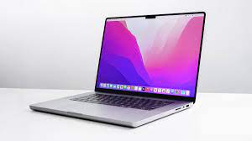
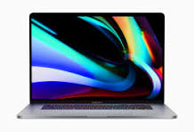
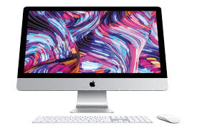
The Apple Pro 2024 Laptop
BY:Sanav,Janav,Ripley,Aanya

Slide 2


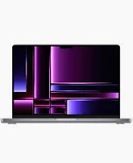

Laptop Size and Dimensions, Features
16.2’’ display
Easy to open
Easy to work with

Slide 3
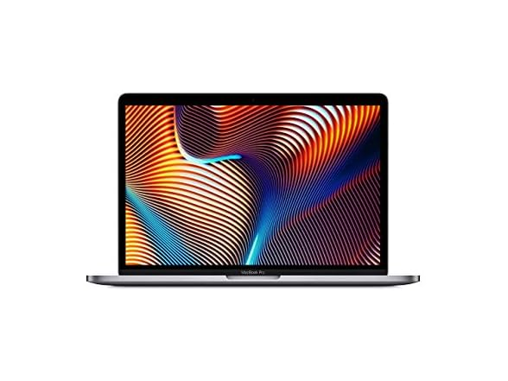
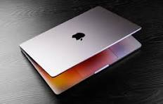
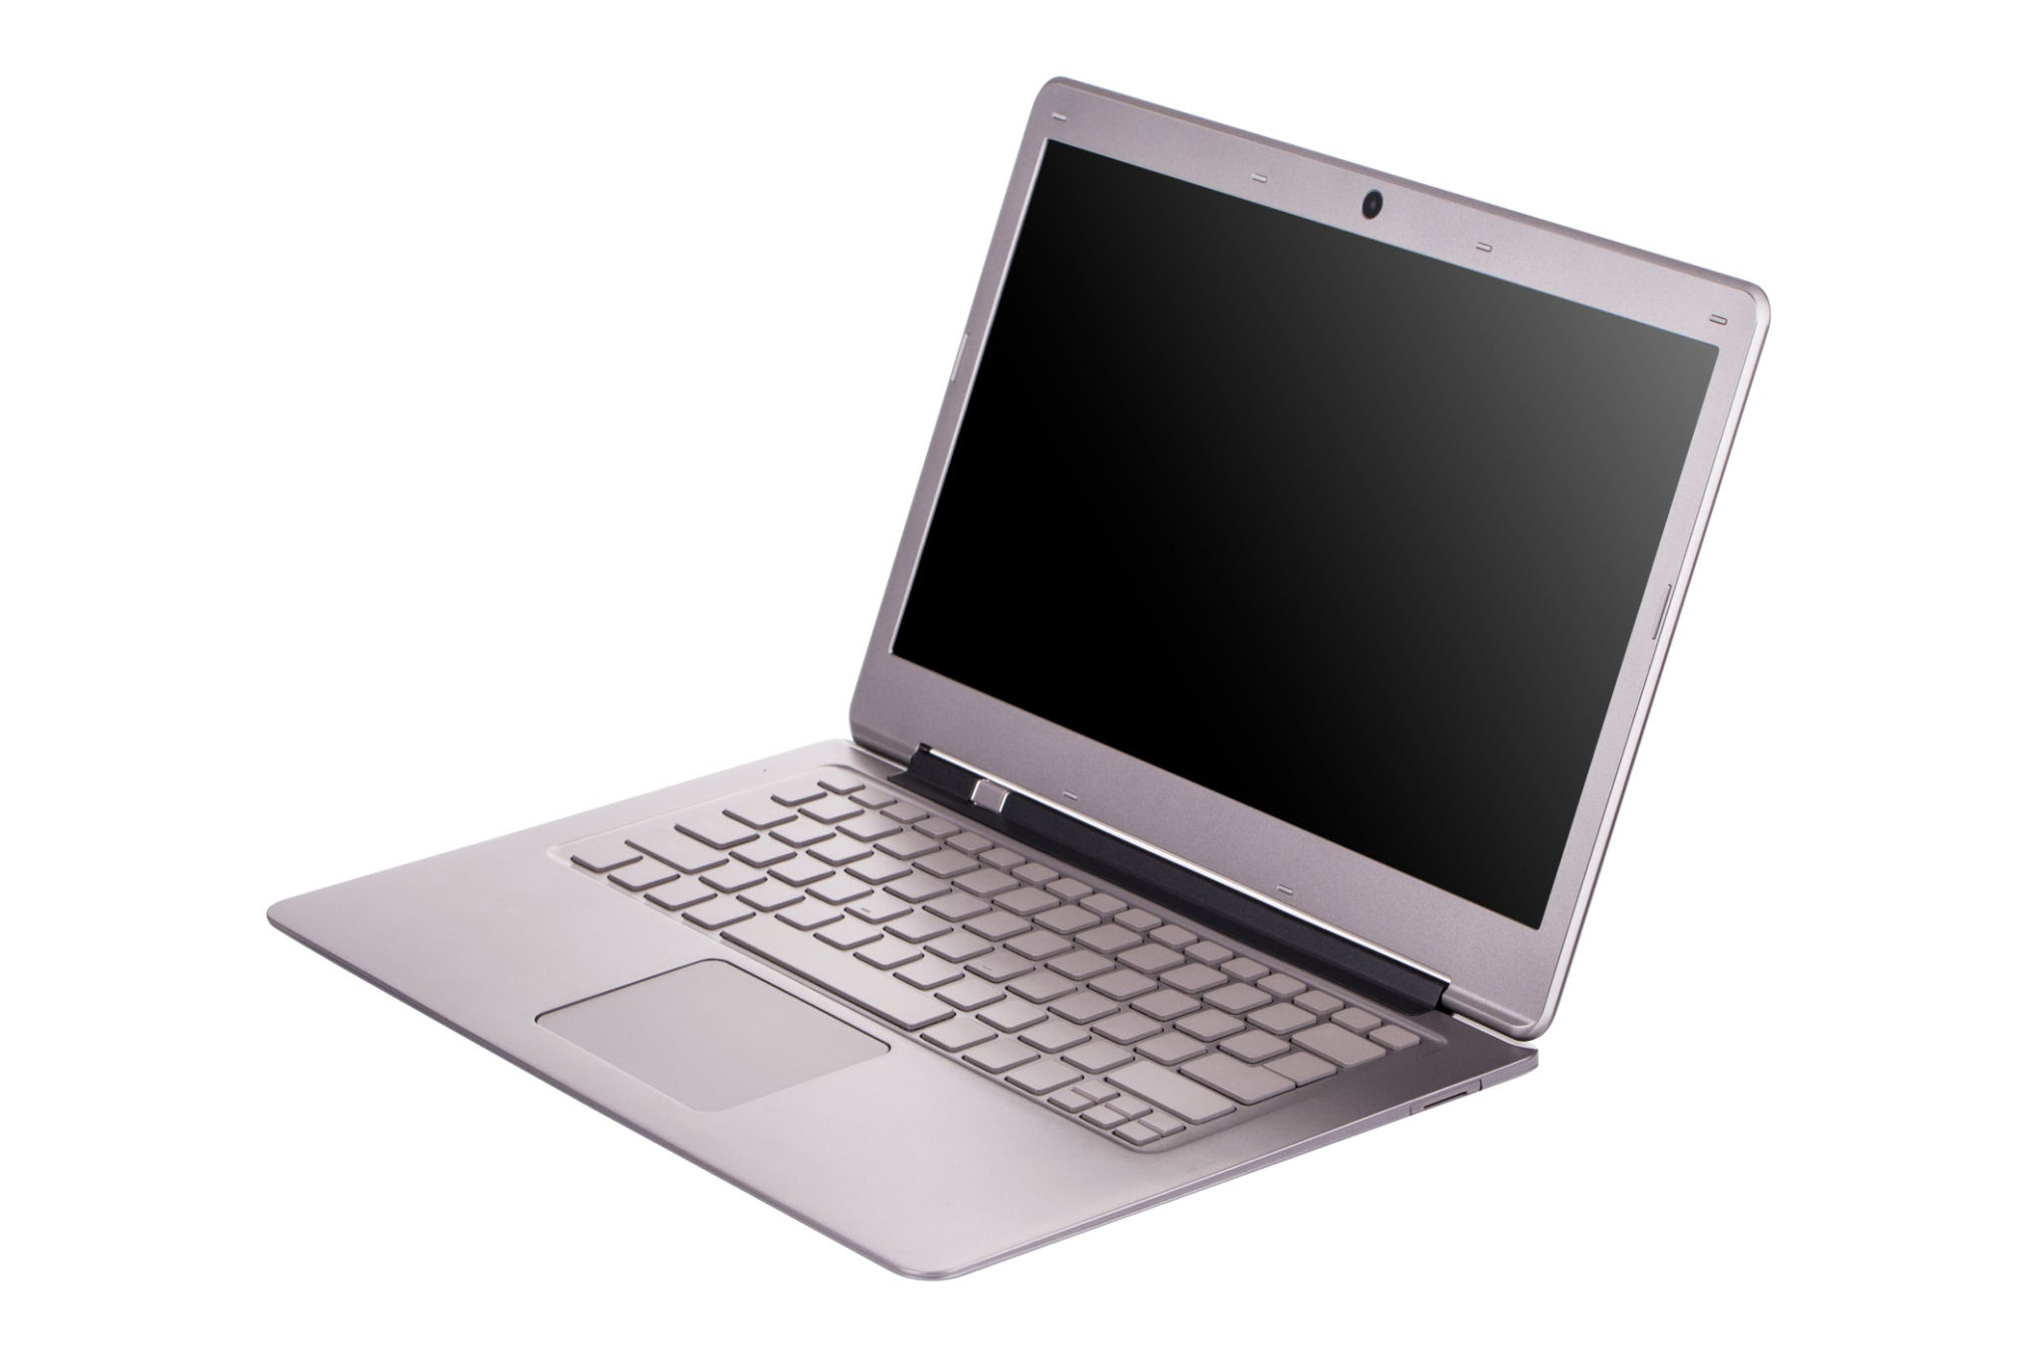

The price
$2,615.00 =)

Slide 4



Why it’s good for your audience
For Youtubers-
This Laptop is good for watching youtuber like for on any device
This Laptop entertains you when you are bored- just like how youtube entertains you
When you aren’t in a good mood, this Laptop makes you happy again

Slide 5


Thanks for listening to this presentation!
Thank you!

